Slide 1
2024 New Kernel Training

Slide 2
Welcome: Popcorn Empire
Katy Teitzel – Volunteer Council Kernel
Chelsey Donat – Council Popcorn Staffer
Assistant Council Kernels
Chelsy Houy
Rose Saxton
Alamo Area Council Staffers
Ted Borcherding
Steven Verm

Slide 3
Agenda
Sale at a glance
Organizing your Unit’s sale
Tools and resources
Prizes and incentives
Sales Pitch
To Do list
Popcorn Empire

Slide 4
Housekeeping
Kindly hold your questions until the end, OR put them in the chat.
We will be posting links in the chat.
All documents featured tonight will be posted on our Popcorn website

Slide 5
Vendor

Slide 6
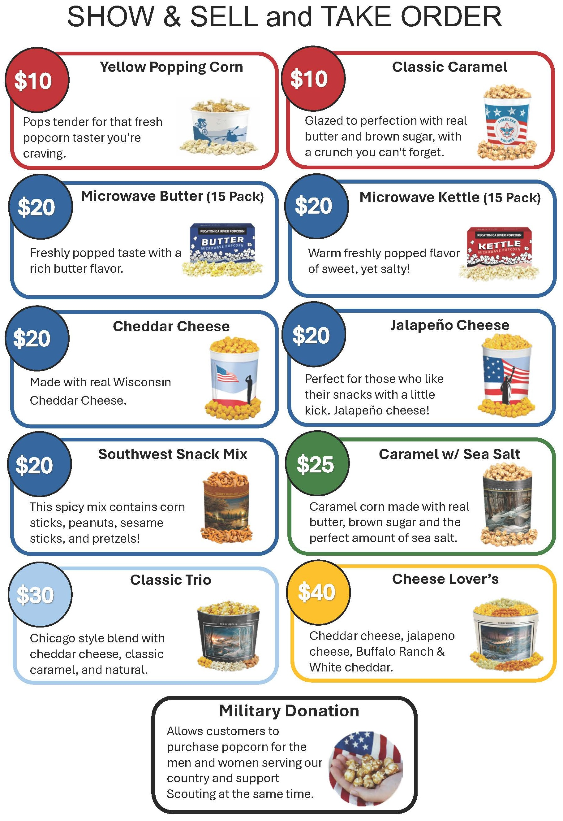
Products (tubs/tins)

Slide 7
Pantry Hours
Starting September 5th - October 31st
Wednesdays: 3:00 PM – 6:00 PM
Thursdays: 9:00 AM – NOON
Fridays: by appointment ONLY (10:00 AM – 2:00 PM)
Open Saturday:
September 28th – 9:00 AM – NOON
CLOSED for walk-ins:
September 27th, October 18th, October 25th and November 1st – 19th

Slide 8
Commission
30% - Base Commission
5% - sign-up by July 10th & sell SNS/TO
3% - NO returns
2% - for selling $10k or more in SNS/TO
40% max commission for in-person sales
All online sales earn 35% commission.

Slide 9
Organizing your sale: Budget
Have an annual program planned
Identify all sources of income
Identify all expenses
Determine your cost per Scout
Set your Popcorn goal
Share your budget and goal with parents and Scouts

Slide 10
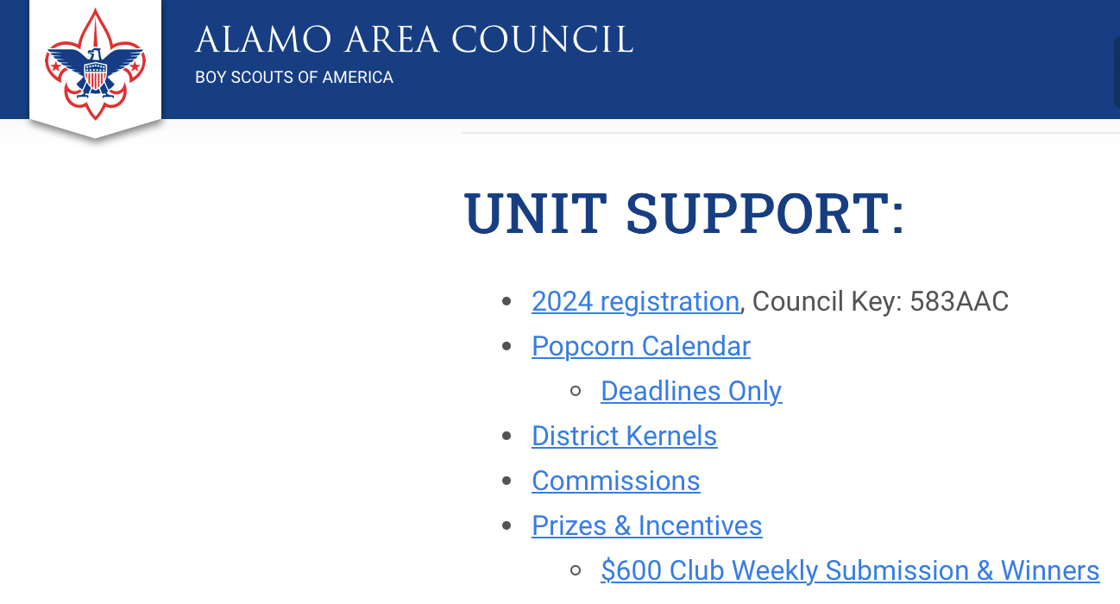
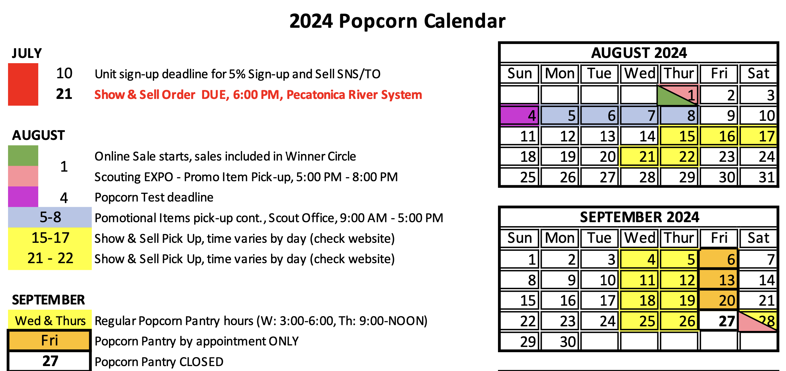
Organizing your sale: Calendar
Council deadlines
Be sure to give yourself enough time!

Slide 11
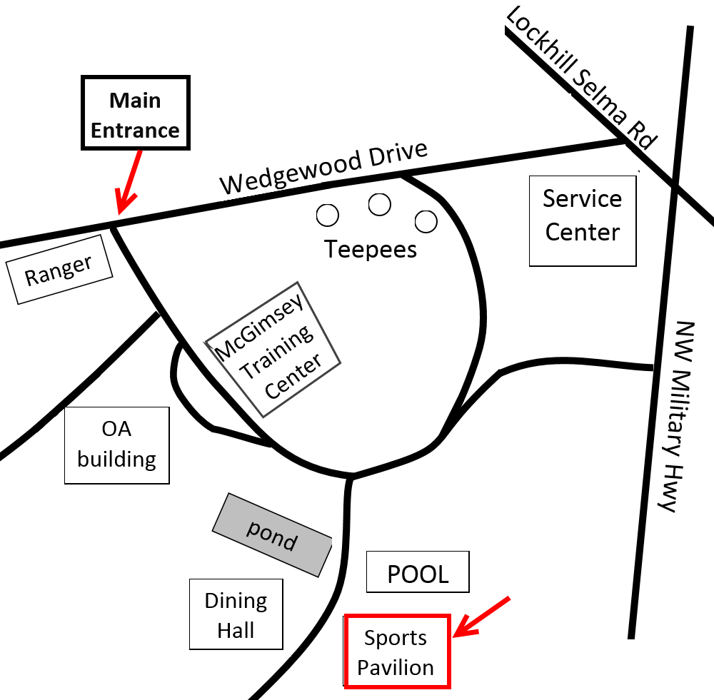
Organizing your sale: Pantry
Only order/pick up what you need
Reorders (8:00 AM Friday – 11:00 PM Sunday)
Pick up popcorn
If not listed in Scout Boss email popcorn@alamoareabsa.org
Wednesdays: 3:00 PM – 6:00 PM
Thursdays: 9:00 AM – NOON
Fridays: by appointment ONLY
(10:00 AM – 2:00 PM)
50% commission due Council required to pick up additional product.

Slide 12
Organizing your sale: Ways to Sell
Show & Sell
Show & Deliver
Take Orders
Provide a receipt with parent contact information and expected drop off date of product.
Online (Aug. 1st – Nov. 24th)

Slide 13
Organizing your sale: SHARE
Put it in WRITING ✭
Show them what popcorn can pay for!
Explain your expectations
Pick-up/return
Sales reporting
Phone calls/text timing
AVOID BURNOUT!

Slide 14
Organizing your sale: Motivation
Keep Scouts/families motivated
Shout outs
Weekly prizes
Competitions
Unit prizes
*Review page 28 in the Unit Kernel Handbook

Slide 15
Organizing your sale: Tracking
Document, Document, Document
Keep records for future use
Be sure to give receipts!
If you check out popcorn to Scouts – have them report their sales regularly
We’ll talk more about this ...

Slide 16
Organizing your sale: Donations
Units (Scouts) are NOT allowed to solicit
As a rule of thumb, fundraising is when the donor gets something in return (like Popcorn or a clean car).
Any fundraising effort must be APPROVED BEFOREHAND
use the “Unit Money Earning Application”
Camp Cards and Popcorn sales are already approved
Donations are OK
Put out a Donation jar
All donations collected while selling popcorn are to be used the following ways:
Buy excess inventory with American Hero donations, product must be donated
More donations than excess inventory?
Add donations to your Take Order. You make commission!
REQUIREMENT – complete American Hero Donation form & submit pictures of delivery to popcorn@alamoareabsa.org

Slide 17
Council SNS Locations:
Bass Pro Lottery
Dates still pending approval – September/October
Once approved, lottery will be announced on BAND and Popcorn Press
Lowe’s
Based on the stores request sign-ups will be shared via direct email to Scout Boss Unit contact or signupgenius.com
Murdoch’s
Store has requested local Units only
Wal-Mart – Spark Program
Helotes - 78023
Floresville - 78114
Boerne - 78006
Leon Springs - 78257

Slide 18
Tools and Resources

Slide 19
Technology: Pecatonica site
Scout Boss – order popcorn, invite Scouts, reports, Winner’s Circle entries

Slide 20
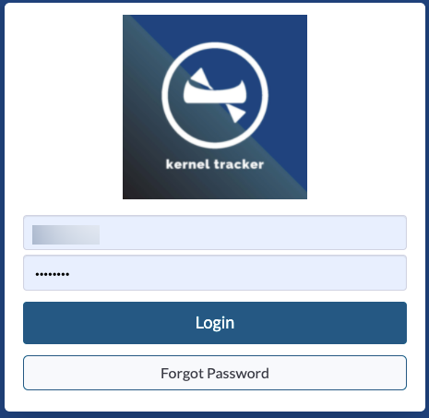
Technology: Pecatonica site
Kernel Tracker – keep track of how much popcorn you have checked out to each Scout.

Slide 21
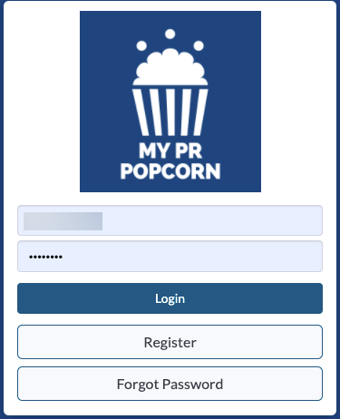
Technology: Pecatonica site
My PR Popcorn – Scout profile

Slide 22
Technology: Band
Use the app OR your computer
Network with other Kernels
Direct updates and notifications from Popcorn Empire

Slide 23
Trackers:
PR’s Worksheet Tool
Popcorn check out sheets
Get signatures!!
Show & Sell sales sheets
Other trackers provided by Council
Use what works for YOU!

Slide 24
Pop Swap: Unit-to-Unit transfers
ONE Unit completes the online POP SWAP form
Both Units will receive an email once invoices have been updated.
Paper forms are for your reference
Does NOT count as a return!!!

Slide 25
The Popcorn Press: Council email
All 3 Unit Leaders will receive this periodic email
Haven’t received a Popcorn Press? Check your spam folder!
Click to see old issues:

Slide 26
Kernel’s Korner:
Pop in and ask your questions, listen for tips, or seek advise.
A virtual open forum
No training will be offered during this time.
Kernel’s Korner will be hosted periodically throughout the sale.
All dates will be posted in Band.

Slide 27
Council’s Popcorn website:
alamoareabsa.org/resources/popcorn/
Lots of Unit resources
Links to important reports etc.

Slide 28
Pecatonica River: Tech support
pops@prpopcorn.com

Slide 29
Prizes and Incentives

Slide 30
Council Prizes:
$50 Patch
$600 Club weekly drawing
$800 t-shirt
Top 100 ranking & Spin-and-Win Party
Top 100 Scouts and one (1) adult guest invited!
Spring 2025
Entry into drawing for an Amazon.com gift card for the Unit for each week you report!

Slide 31
Unit prizes:
Be creative!
NO Scout Accounts
Unit Prize ideas – pg. 28

Slide 32
Prize Submission Links:
Council link available in October
$50 Patch
$800 t-shirt
Top 100 ranking & Spin-and-Win Party
Top 100 Scouts and one (1) adult guest invited!
$600 Club weekly drawing
Submission due each Monday by 10:59 PM
https://www.alamoareabsa.org/popcorn/600club/
Entry into drawing for an Amazon.com gift card for the Unit for each week you report!
Submission due each Monday by 10:59 PM
https://form.jotform.com/AlamoAreaBSA/2024WeeklyUnitReporting

Slide 33
Sales Pitch:
Class A uniform!
Sell Scouting!
Ask YES questions
Stand up and be inviting
Sample:
Hello my name is _____ and I’m with Pack/Troop _____.
My goal is to _________. May I count on your support?

Slide 34
To Do list:
Make sure 2 Unit contacts are listed in Scout Boss
Send the name and contact info for a 3rd Unit Leader to popcorn@alamoareabsa.org
Popcorn Test (2 leaders was due 8/4)
Review the suggestions in your Unit Kernel Handbook
Schedule your Unit kick-off and TRAINING
Join Band
Get to know your Council Kernel and Assistant Kernels!
Attend Scouting EXPO on August 1st at UIW

Slide 35
Important Deadlines:
August 4th – Popcorn Test Due
Two (2) Unit popcorn Unit leaders must complete and pass to pick-up popcorn starting 8/15
September 28th – LIMITED returns deadline (max 10%)
Units receive 3% commission for NO RETURNS
October 20th – Unit TAKE ORDER Due by 6:00 PM
November 3rd – Council Prize Submission Due
November 24th – American Hero Donation Form Due
December 1st – Winner Circle Prize Submission Due
December 3rd – Final Payments Due by 5:00 PM
-5% commission for NOT meeting the December 3rd deadline

Slide 36
Recorded Trainings
Recordings of the following trainings are available on Council’s popcorn webpage:
alamoareabsa.org/resources/popcorn/
New Kernel Training – July 29th
Budget Training
PR Technologies Training available on:
https://pecatonicariverpopcorn.com/TrainingVideos.html

Slide 37
Popcorn Empire
popcorn@alamoareabsa.org
Volunteer Council Kernel, Katy Teitzel
Council Popcorn Staffer, Chelsey Donat Chelsey.Donat@scouting.org

Slide 38
Questions

